Slide 1

Design Database

Slide 2


Slide 3
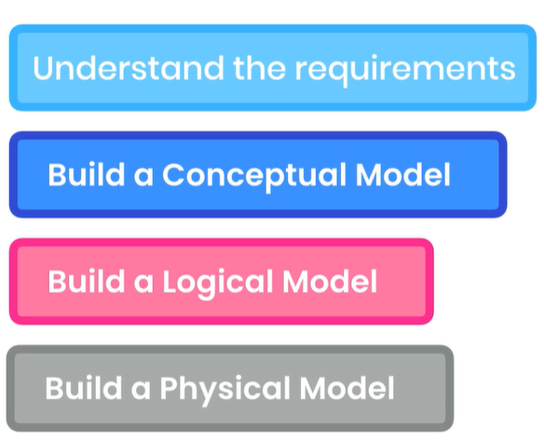
Data modelling
Understand the requirement
Analysis the bussing recrement
Contact domain expert and customers
Build conceptual model visual representation of the concepts
Logical model Abstract data model that independent of database technology it just show u the tables that u need
Build a physical model is the implementation of logical model with practical database technology for example MySQL

Slide 4
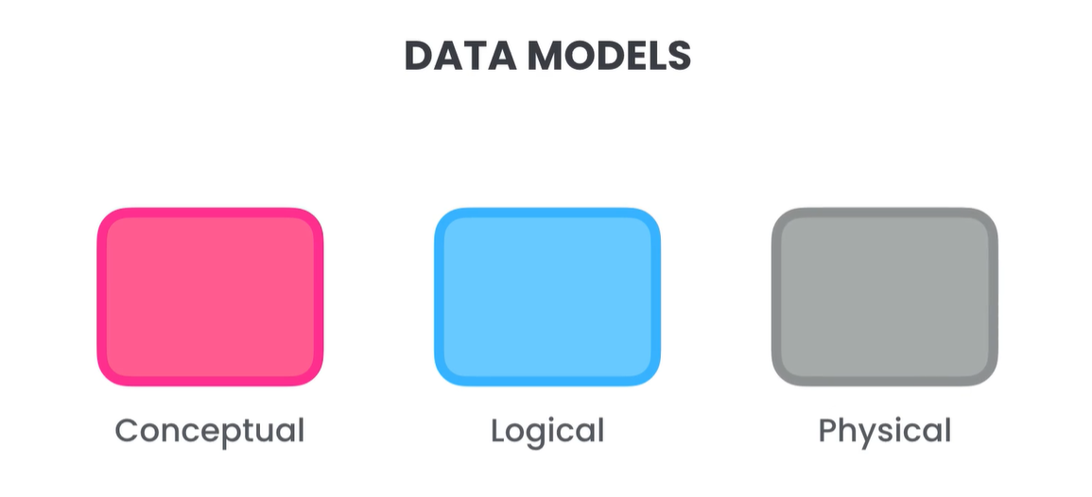

Slide 5

Concetpual Models
We going to build online courses database

Slide 6

Concetpual Models
Concetpual Models, that represents the entities and their relationships
What entities we have ? Students & Courses
How we can represent the relationships between entities in two ways:

Slide 7

Modelling TOOLS

Slide 8
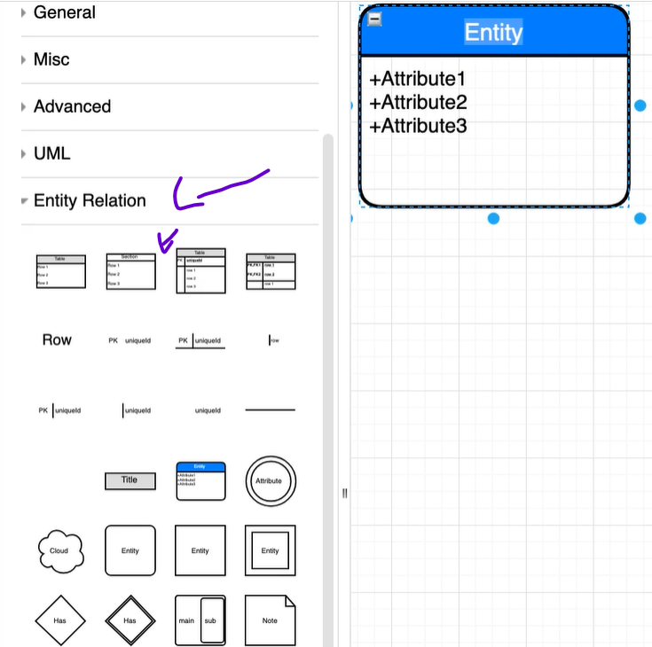
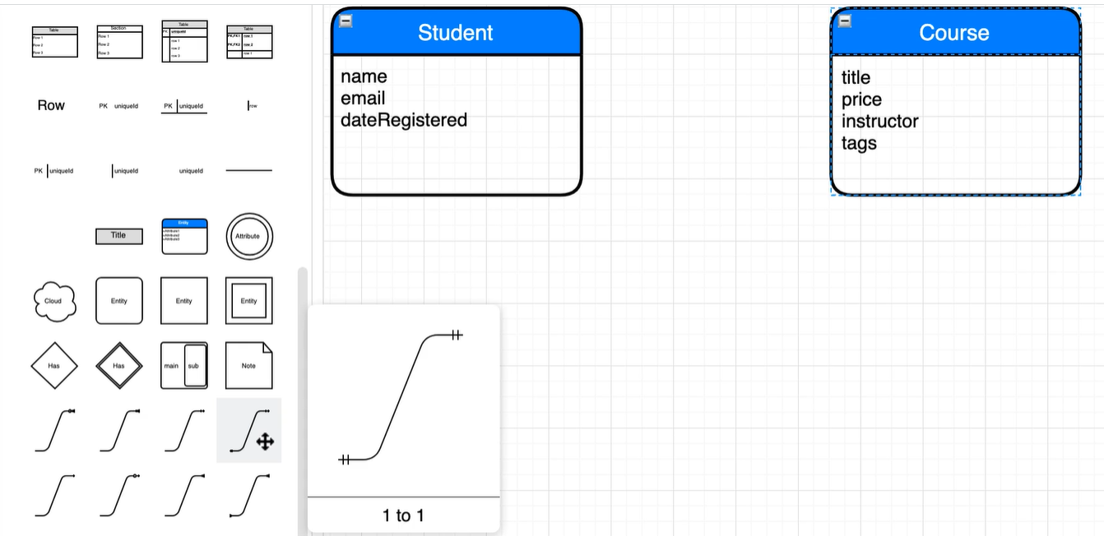
Draw.io

Slide 9
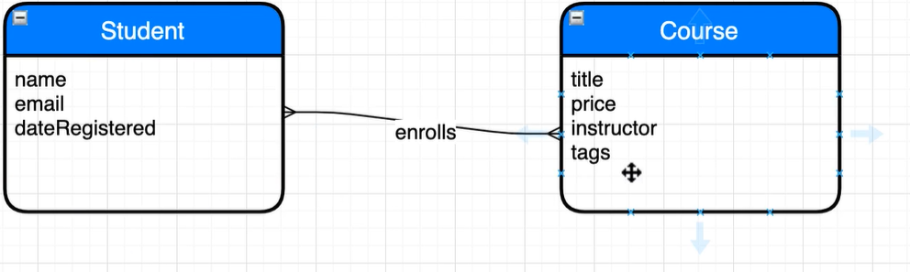
Draw.io

Slide 10
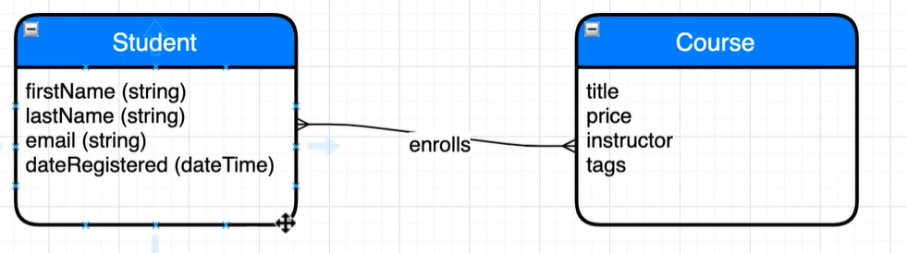
Draw.io Logical Model
Add types we use string and not varchar because string is general independent from any database type
What if we need to know the data of the registration date to the course ? Add the price where ?

Slide 11
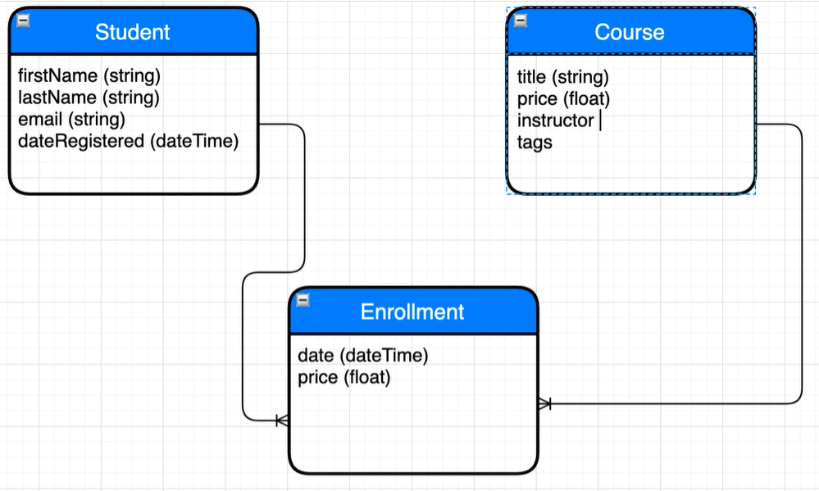

Slide 12
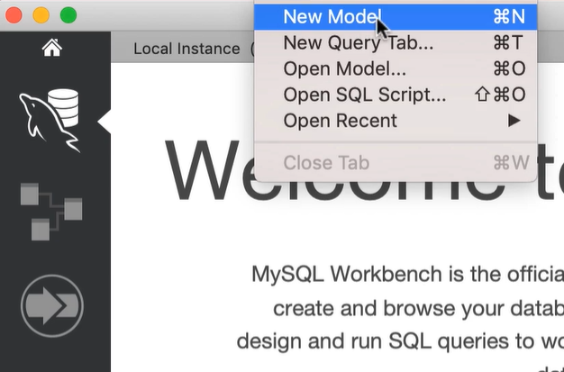
Physical Model
A physical model is implementation of logical model for a specific database technology

Slide 13
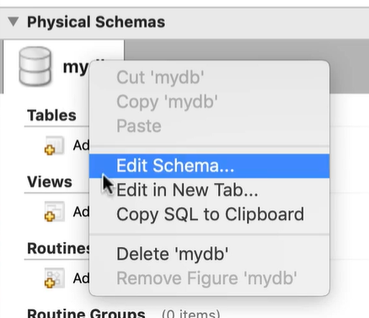
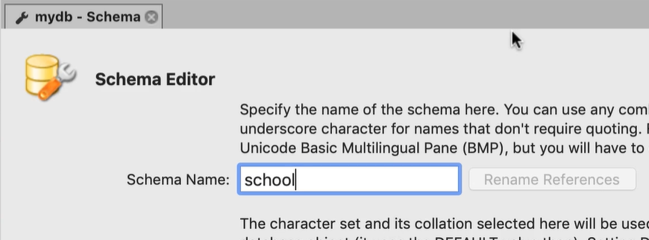
Physical Model
Change the default name of database from my Database to school

Slide 14
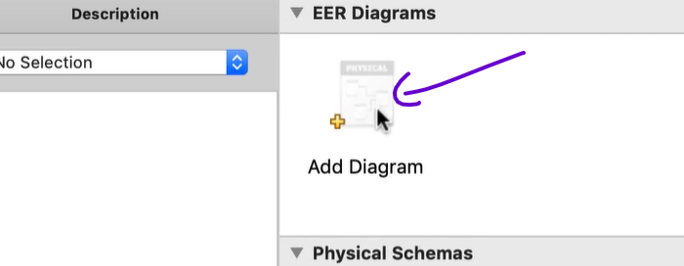
Physical model
Click on add new diagram

Slide 15

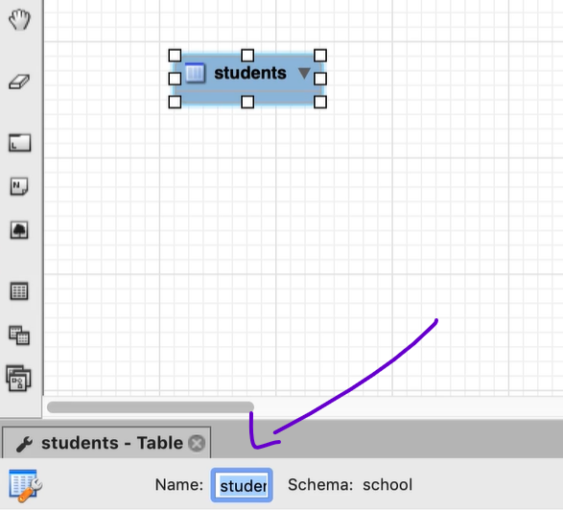
Add table
Double click on table change the name

Slide 16
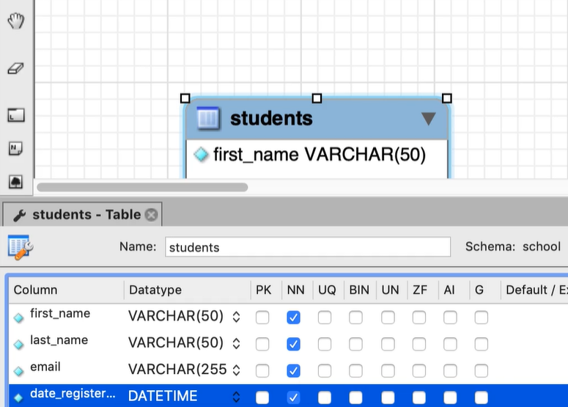
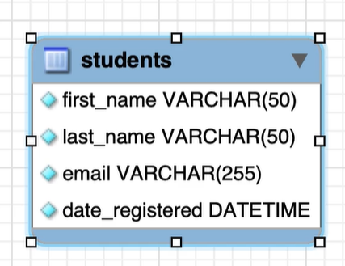
Add column to table (Physical model)

Slide 17
Exercise add another tables

Slide 18
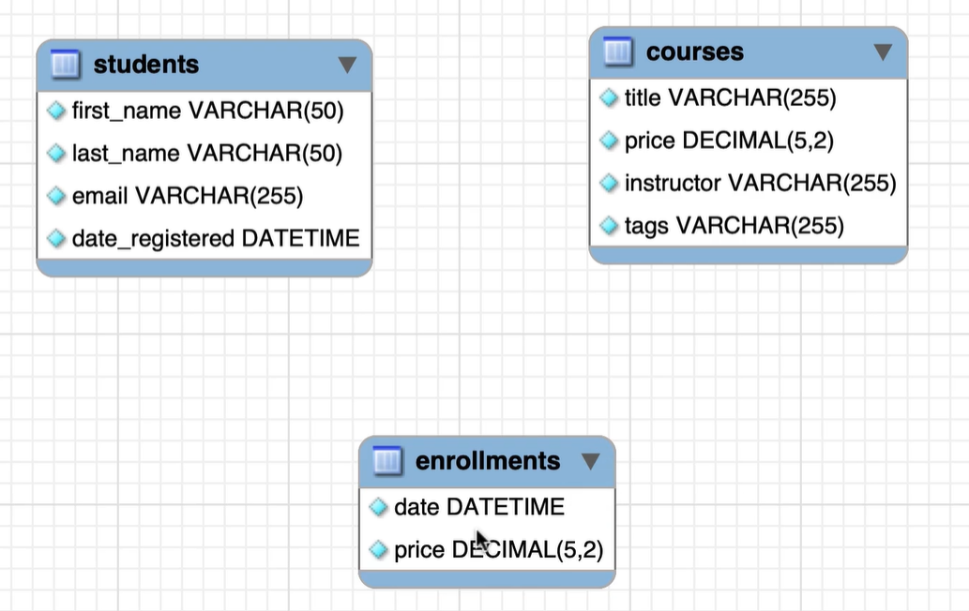
Solution

Slide 19
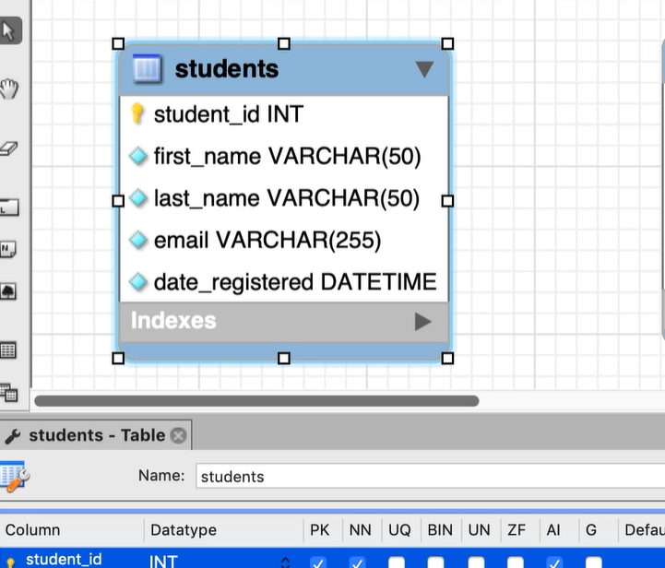
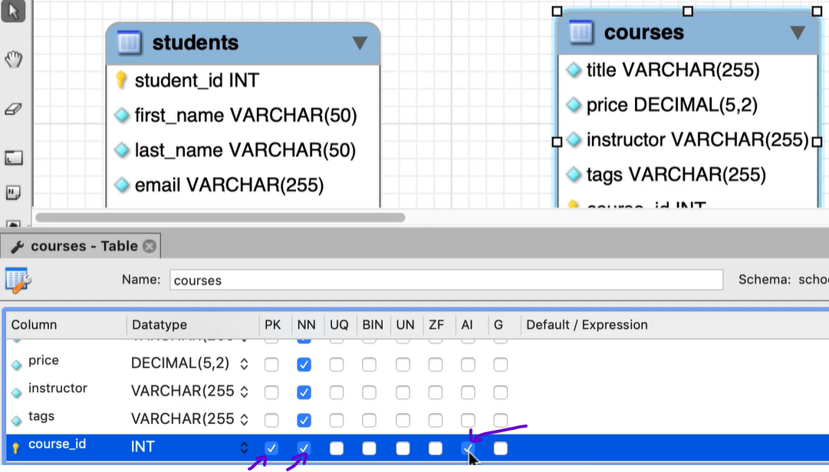
Primary key
Now we need to add primary key to each table. As you know primary key is a column that uniquely identify each record in the table.
Composite primary, is one that has multiple columns

Slide 20
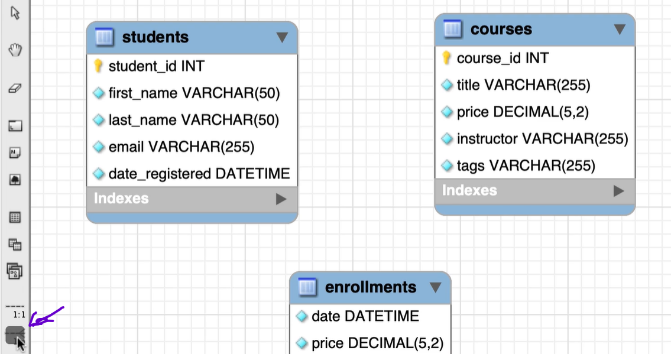
One to many relationship
One to many relationship between students and enrollments, so student can have a multiple enrollments.

Slide 21
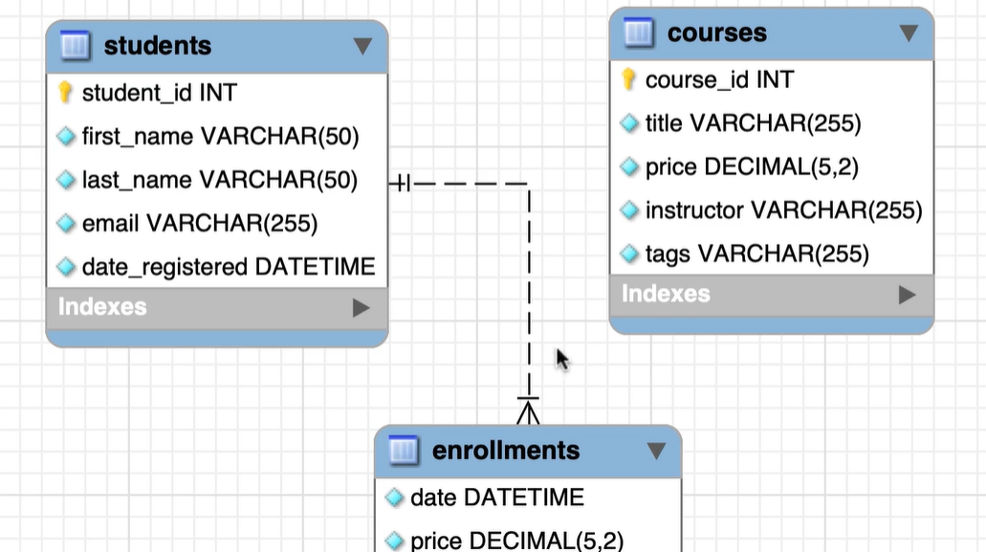
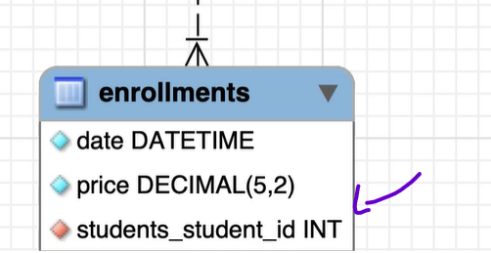
One to many
Click on the icon one to many then click the enrollments table then the student's table

Slide 22
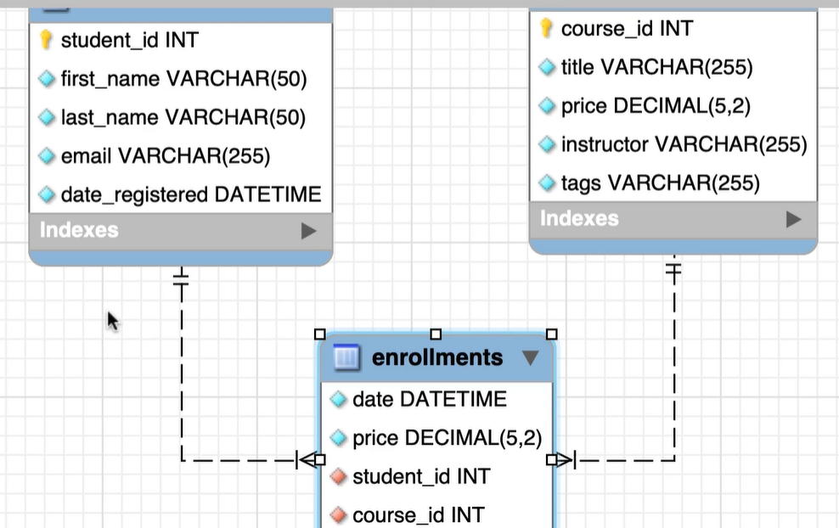
One to many

Slide 23
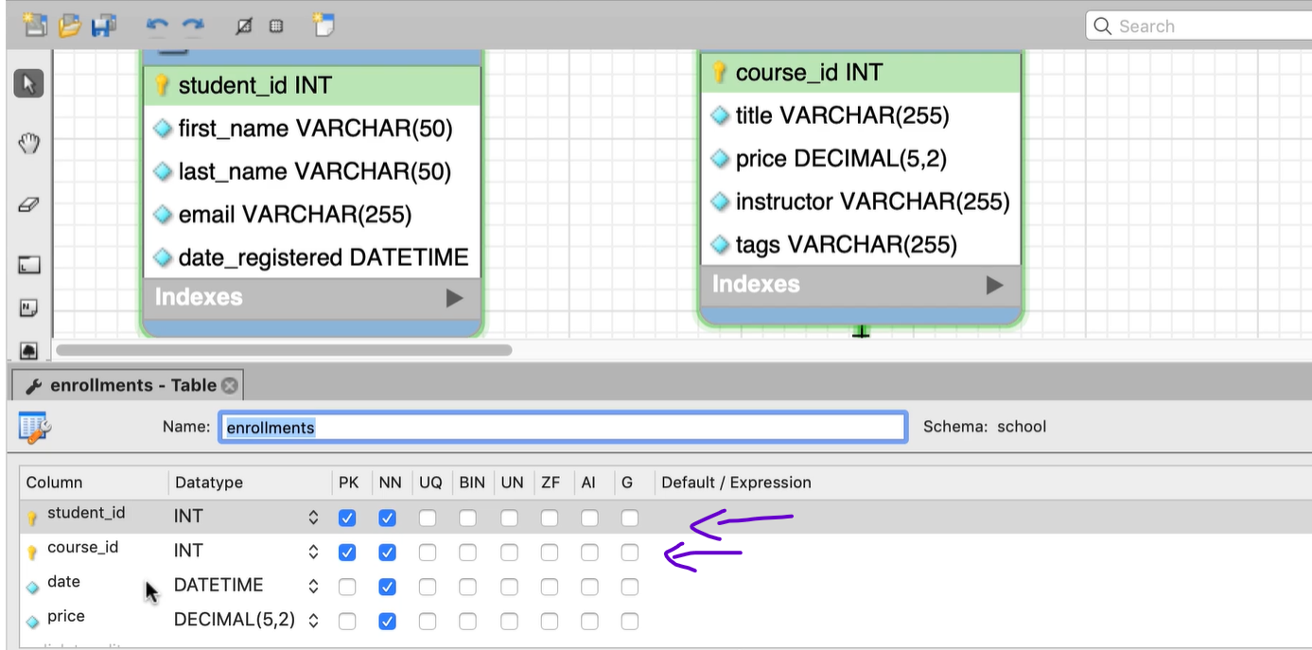
Composite Primary key

Slide 24
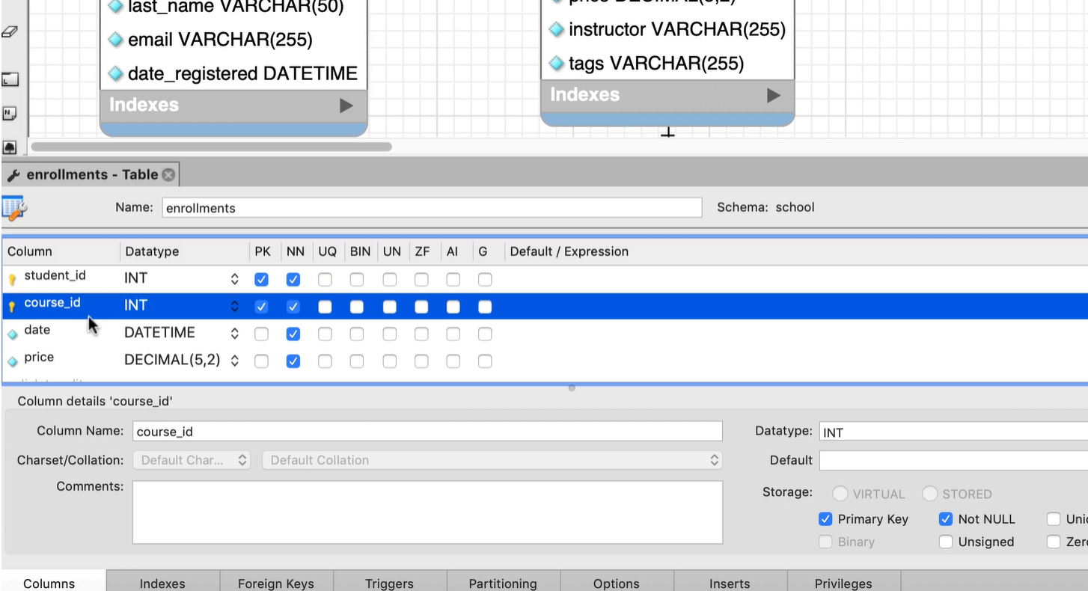
Foreign key constraints
Basically, protect the data from getting corrupted
Student_id reference to primary key in student's table
Course_id reference to primary key in courses table

Slide 25
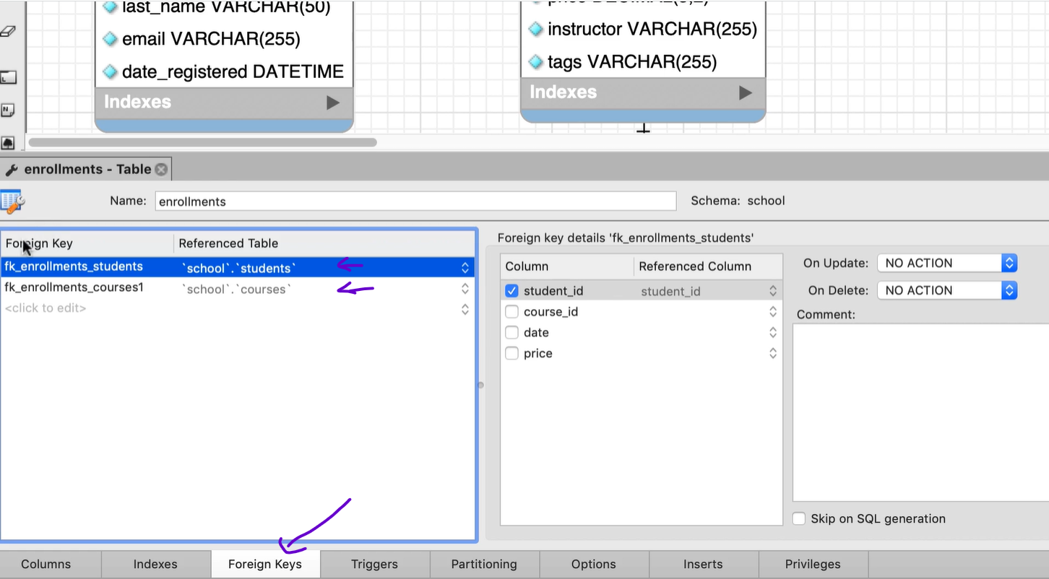
Foreign key

Slide 26
Foreign key
Two dropdowns On Update, On Delete
What should happen when the corresponding record in your parent table gets updated or delete
For example, what should happen when the id of student get changed!
When primary key get changed u want to make sure that the foreign key get updated
So, for example if the id of student changed from 1 to 2, you want to make sure that all the enrollments for that student also updated so they reference to student id 2
CASCADE – MySQL will automatically update the records in the child table if the primary key changes
SET NULL – MYSQL will automatically update the foreign key to null if the primary key changed
NO ACTION – MySQL will prevent the update option.
RESTRICT –MYSQL will prevent the update option
CASCADE – in delete, when delete student the record will be deleted as well.

Slide 27
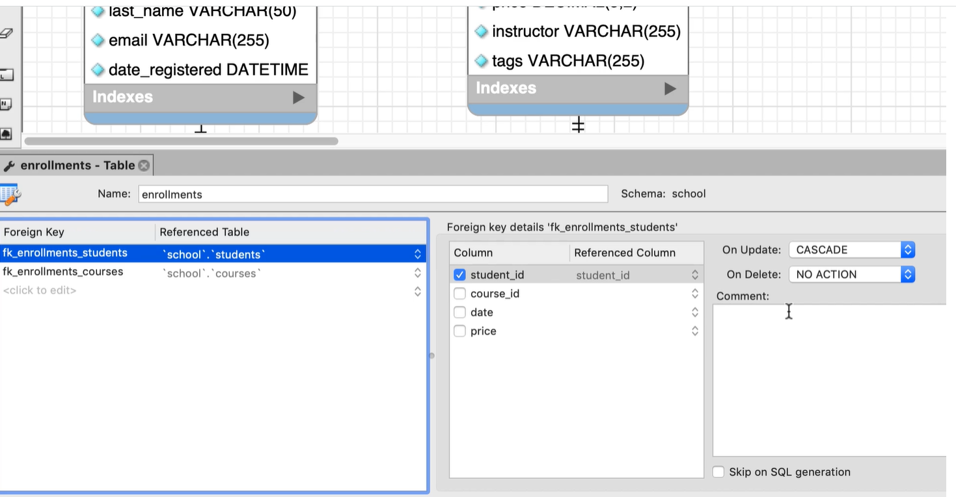
Foreign key

